Slide 1
The h-index Metric for GitHub
Adapting academic impact measurement for developer influence
Mykhailo Pavlov • Comenius University, Bratislava
Supervisor: Mgr. Marek Šuppa • Comenius University, Bratislava
Notes:
My name is Mykhailo Pavlov, and today I will present my bachelor thesis titled 'The h-index Metric for GitHub,' supervised by Mgr. Marek Šuppa at Comenius University.
In academia, we measure impact by citations. But on GitHub, where millions of developers collaborate, there is no standard metric for code influence. My work bridges this gap by adapting the academic h-index for software development, building a scalable data pipeline, and creating a machine learning model to predict developer impact.

Slide 2
The h-index: A Standard for Scientific Impact
Proposed by Hirsch in 2005, the h-index has become the standard metric for measuring researcher influence in academia.
Simple Definition
Example
Interpretable
A scientist has index h if h of their papers have at least h citations each
h = 10 means 10 papers with at least 10 citations each
Simple, interpretable, and widely adopted in academia
Notes:
Let's start with the foundation. The h-index was proposed by Jorge Hirsch in 2005 and has become the gold standard in academia.
The definition is simple: A scientist has an index h if h of their papers have at least h citations each. For example, an h-index of 10 means 10 papers with at least 10 citations.
It is valuable because it balances productivity with impact. It prevents a researcher from being ranked highly based on just one popular paper.

Slide 3
Why GitHub Lacks a Standard Impact Metric
GitHub hosts millions of developers, but lacks a unified way to measure influence.
Decentralized Platform
Current Proxy
The Gap
Activity is spread across repositories, organizations, and contributions
Common proxy: follower count, but this measures popularity, not code quality
Need a simple, interpretable metric grounded in actual technical impact
Academia
GitHub
Papers + Citations
Repositories + Stars
Notes:
However, GitHub lacks this standard. It is a decentralized platform where activity is spread across repositories and organizations.
Currently, people use 'follower count' as a proxy for influence. But this measures social popularity, not code quality. You can have 10,000 followers but write code that no one uses.
This creates a gap. We need a metric grounded in technical impact, not social reach. Just as academia h-index uses Papers and Citations, GitHub will use Repositories and Stars.

Slide 4
From Followers to Stars: A Better Metric
The Problem
The Solution
A user can have 10,000 followers but few starred repositories. Followers reflect social reach, not code quality or reuse
Adapt the h-index to GitHub
New Mapping
GitHub h-index
Articles → Public repositories,
Citations → Repository stars
Largest h where a user has h repositories with at least h stars each
Notes:
This is the core hypothesis of my thesis. We adapt the h-index to GitHub by changing the mapping.
Articles become public repositories. Citations become repository stars.
The GitHub h-index is defined as the largest number h where a user has h repositories with at least h stars each.
This shifts the focus from 'who knows you' to 'who uses your code.' It is a measure of reuse and technical value.

Slide 5

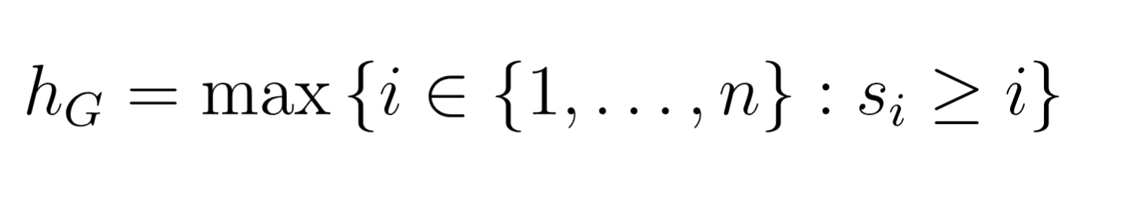
The GitHub h-index: Core Definition
Adapted from the academic h-index, the GitHub h-index measures developer impact through repository popularity rather than research citations.
Analogy to Academic h-index: Researcher has h papers with h citations each
GitHub: Developer has h repositories with h stars each
Where s_i represents stars on the i-th repository (sorted by stars in descending order), repositories replace publications, and stars replace citations.
Notes:
Formally, where s_i represents the stars on the i-th repository, sorted in descending order.
The algorithm sorts a user's repositories by star count. It then iterates through the list, checking if the star count is greater than or equal to the current position index.
The process stops when the condition fails. The last valid index is the h-index.
This ensures that a user with one repository of 1,000 stars still has a lower h-index than a user with 10 repositories of 10 stars each, rewarding consistent contribution.

Slide 6
Example: Calculating h-index Step by Step
Consider a developer with five repositories sorted by star count:
Repository
Stars
Check: ≥ Position?
web-app
12
Yes (12 ≥ 1) ✓
api-service
8
Yes (8 ≥ 2) ✓
data-tool
5
Yes (5 ≥ 3) ✓
cli-utils
3
No (3 < 4) ✗
config-lib
1
No (1 < 5) ✗
Result
h-index = 3
The developer has 3 repositories with at least 3 stars each. The 4th repository has only 3 stars, which is less than 4.
Notes:
Let's look at a concrete example. Consider a developer with five repositories.
We sort them by stars: 12, 8, 5, 3, 1.
We check the condition: Is stars ≥ position?
12 is ≥ 1. Yes.
8 is ≥ 2. Yes.
5 is ≥ 3. Yes.
3 is ≥ 4. No.
The condition fails at the fourth repository. Therefore, the h-index is 3.
This developer has 3 repositories with at least 3 stars each. This calculation is performed for every user in our dataset.

Slide 7
Data Collection at Scale: 3.5 Million GitHub Users
A large-scale data collection effort that efficiently gathered information from millions of GitHub profiles using GraphQL technology.
Why GraphQL API (not REST)
Fetch multiple resources in a single query
Reduces total API calls by ~70%
Essential for collecting repositories, stars, and profiles efficiently
Scale Achieved
~3.5 million users collected
All public repositories and star counts retrieved
h-index computed for each user
Challenge
GitHub API has strict rate limits per token per hour
Notes:
To validate this metric, I needed data. I collected information on approximately 3.5 million GitHub users.
The main challenge was the GitHub API rate limits. Each token is limited to 5,000 points per hour.
I chose the GraphQL API over REST. GraphQL allows fetching multiple resources in a single query, reducing total API calls by roughly 70%.
This efficiency was essential to collect repositories, stars, and profiles for millions of users within a reasonable timeframe.

Slide 8
Reliable Data Collection Under API Limits
TokenManager – Multi-Token Rotation
Implemented a class to rotate among ~8 authentication tokens
Each token checked via HTTP headers before use
On 403 error, automatically switch to next available token
Effectively multiplies daily API quota
Checkpoint System – Fault Tolerance
Save progress to disk after each batch
If connection fails or program stops, restart from last saved point
Prevents re-collecting already-processed users
Parallelization – Speed Optimization
Multiple tokens used simultaneously in parallel threads
Batch processing: collect users → save → continue
Reduced total collection time from weeks to days
Notes:
To overcome rate limits, I implemented a TokenManager class.
This system rotates among multiple authentication tokens. If one token hits a 403 error, the system automatically switches to the next available one.
Crucially, this multi-token rotation increased our data parsing speed by 8 times compared to a single token.
I also added a checkpoint system. Progress is saved to disk after every batch. If the program crashes, it resumes from the last saved point, preventing data loss during long-running collection tasks.

Slide 9
How We Collected Users and Computed h-index
User Enumeration Strategy
GraphQL returns max 1000 users per query (10 pages × 100 users)
To collect broadly, we batched by: Follower count (high to low) and Registration date (chronological batches)
Prioritized active/popular users; some zero-follower users excluded
Repository Parsing and h-index Calculation
For each user: fetch all public repositories via GraphQL
Extract star count for each repository
Sort repositories by stars descending
Apply formula: hG = max{i : si ≥ i}
Store result with user profile
Error Handling
Handle deleted accounts gracefully (skip and log)
Retry failed requests with exponential backoff
Notes:
For user enumeration, we faced a limit of 1,000 users per query.
To collect broadly, we batched users by follower count and registration date. This allowed us to partition the user space and prioritize active users.
For each user, we fetched all public repositories, extracted star counts, and applied the h-index formula.
We also implemented error handling to gracefully skip deleted accounts and retry failed requests with exponential backoff.

Slide 10
Enriching Profiles for Machine Learning
13 Features Collected for ML Model
Repository Metrics
repo count, total stars, avg stars, median stars, max stars, star variance, stars per repo
Social Metrics
followers count, following count, followers per repo, reciprocity ratio
Profile Metadata
organizations count, bio length
Social Network Links Extraction
Step 1: Direct fields via GraphQL (websiteUrl, twitterUsername)
Step 2: Regex on bio, company, location to find URLs/emails
Step 3: Fallback to public HTML profile page if needed
Classify links: Twitter/X, LinkedIn, Instagram, YouTube, Mastodon, Telegram
Notes:
Beyond the h-index, I enriched profiles for machine learning.
We collected 13 features across three dimensions: repository metrics, social metrics, and profile metadata.
We also extracted social network links using a three-step process: direct GraphQL fields, regex on bio text, and fallback to HTML parsing.
This data allows us to predict the h-index based on visible profile traits.

Slide 11
Why Random Forest for h-index Prediction?
GitHub h-index follows a heavy-tailed distribution with many low values and few extreme highs. Random Forest handles these outliers and non-linear relationships better than linear models.
Heavy-Tailed Distribution
Handles Non-Linearity
GitHub h-index follows a heavy-tailed distribution. Many low values, few extreme highs
Random Forest handles outliers and non-linear relationships better than linear models
Feature Importance
Robust to Skew
Provides built-in feature importance. Helps interpret which factors matter most
Robust to skewed data without extensive preprocessing
Linear Model
Random Forest
Struggles with extremes
Handles tail values well
Notes:
For prediction, I chose the Random Forest algorithm.
The GitHub h-index follows a heavy-tailed distribution. Most users have low values, but a few have extreme highs.
Linear models struggle with these outliers. Random Forest handles non-linear relationships and is robust to skewed data without extensive preprocessing.
It also provides built-in feature importance, which helps us interpret which factors actually drive developer impact.

Slide 12
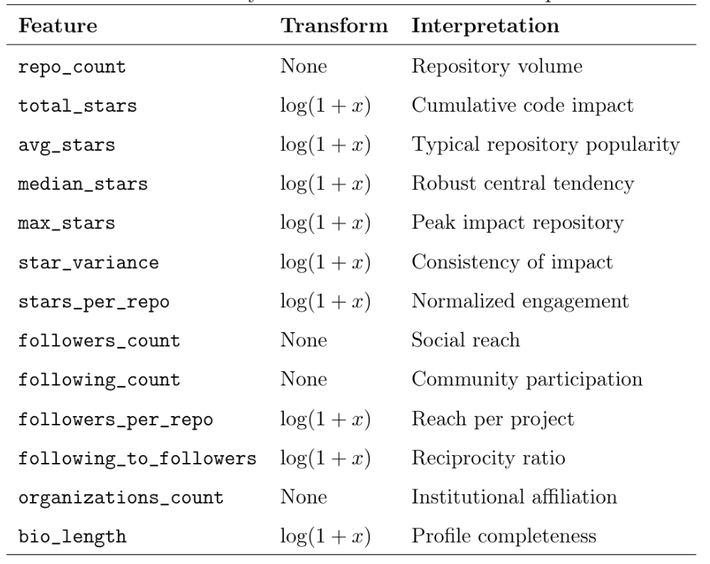
13 Features Across Three Dimensions
Repository Metrics
total stars, avg stars, media stars, max stars, star variance, stars per repo, repo count
Social Metrics
followers count, following count, followers per repo, reciprocity ratio
Profile Metadata
organizations count, bio length
All numeric features log-transformed to stabilize variance where needed.
Notes:
These are the 13 features used for training.
Repository metrics include total stars, average stars, and variance.
Social metrics include followers and following counts.
Profile metadata includes organization count and bio length.
All numeric features were log-transformed where necessary to stabilize variance. This ensures the model converges efficiently during training.

Slide 13
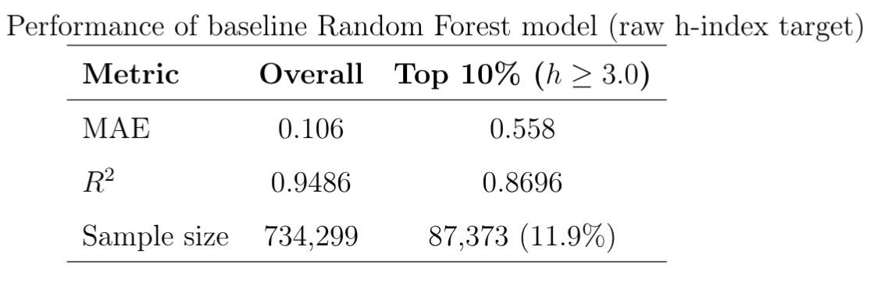
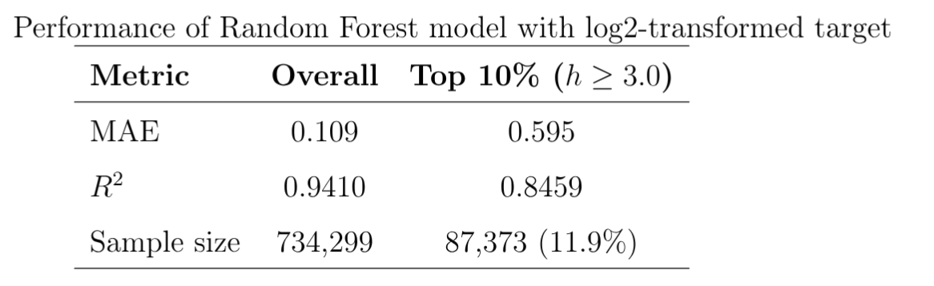
Training Setup and Model Performance
Results on Test Set
Training Configuration
Dataset: 917,874 users after filtering, removed users with zero stars/repos
Split: 80% training, 20% testing, fixed random seed
Parallelized training across CPU cores: ~2.5 minutes per model
Notes:
Here are the results. We trained on 917,000 users with an 80/20 split.
The baseline Random Forest model achieved an R² of 0.9486 and a Mean Absolute Error of 0.106.
However, we must look deeper. For the Top 10% of high-impact users, the MAE increases to 0.558.
This tells us the model is highly accurate for the majority of developers, but predicting extreme values remains challenging. We also tested a log2-transformed model, but the baseline performed better for exact values.

Slide 14
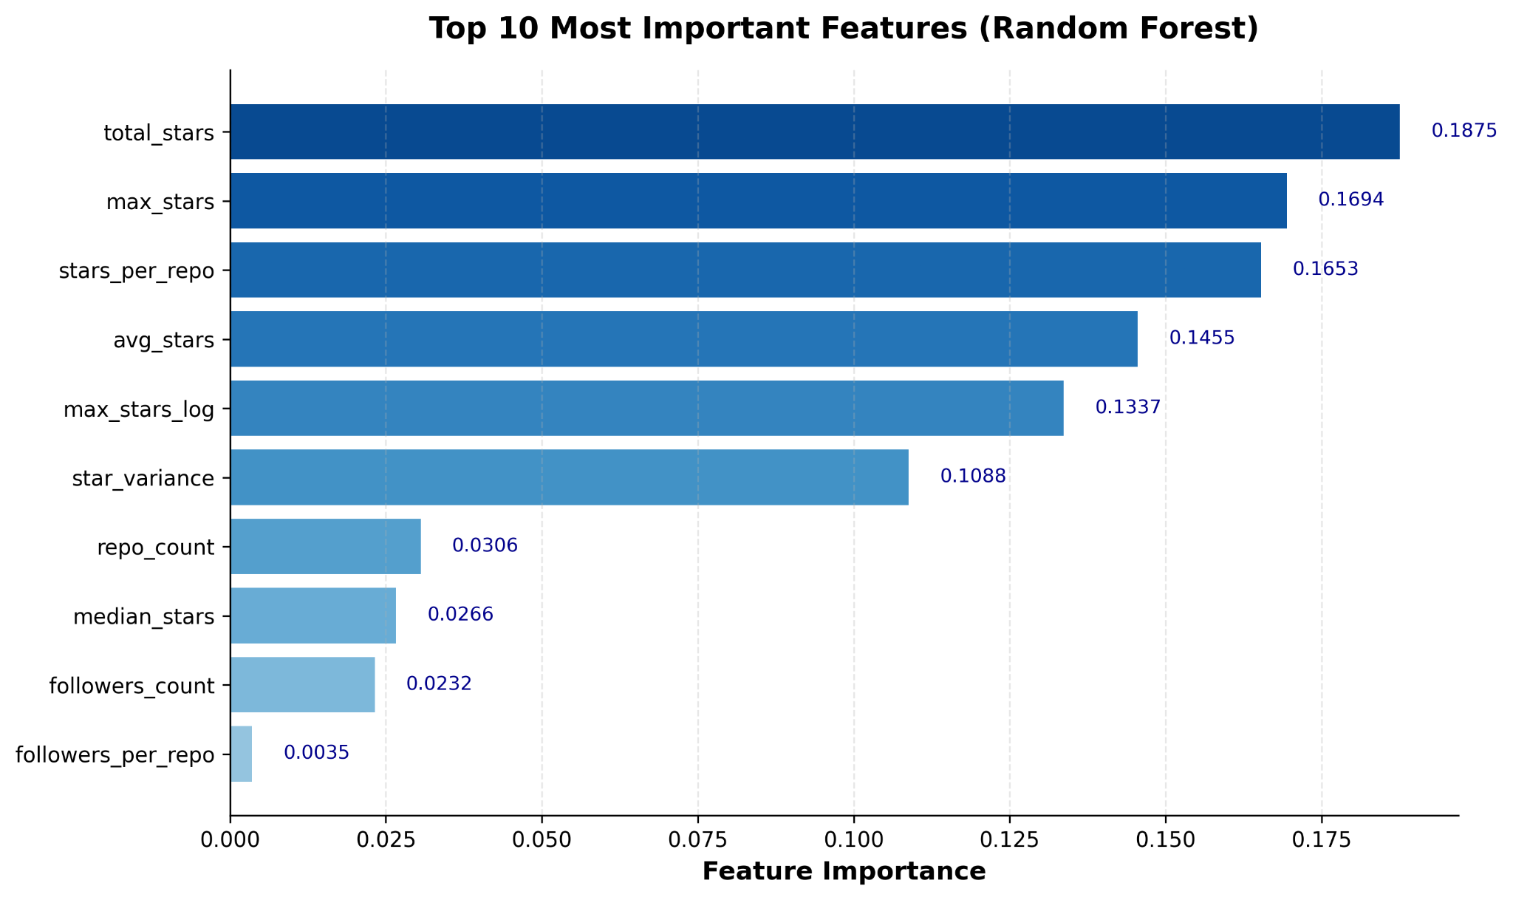
What Drives the GitHub h-index?
Top Predictive Features
Baseline model
Log2-model
Key Takeaway: Code impact drives the GitHub h-index, not social popularity.
Notes:
Looking at feature importance, the results are clear.
In both the baseline and log2 models, Total Stars is the dominant predictor by far.
Repository-level metrics like stars per repo and average stars follow closely.
This confirms our hypothesis: code impact drives the h-index. The visual distribution shows that repository quality outweighs almost all other signals.

Slide 15
What Drives the GitHub h-index?
Key Finding from Feature Importance
Total stars is the dominant predictor — by far the strongest signal in the model
Repository-level metrics follow: stars per repo, average stars, median stars
These metrics reflect consistent code impact across multiple projects
Surprising Result
Social features (followers, following) have very low predictive power
Notes:
The key takeaway here is surprising.
Social features like followers and following counts have very low predictive power.
This validates the GitHub h-index as a technical metric rather than a social one.
A user can be popular on social media but have a low h-index if their code isn't starred. Conversely, a quiet developer with highly starred tools will have a high h-index.

Slide 16

Case Studies: High-Impact Users Are Under-Predicted
Representative Examples from Test Set
User
True hG
Predicted
Error
Profile Note
A
253
63.7
−189
11k repos, 77k followers
B
151
58.4
−92.6
874 repos, 23k followers
C
136
71.2
−64.8
299 repos, 75k followers
Pattern
Users with extreme h-index values are consistently under-predicted
Error grows with true h-index magnitude
Model is reliable for hG < 30, cautious beyond that
Key Takeaway
For very high-impact developers, use predictions as a lower bound.
Notes:
However, we observed a limitation in case studies.
Users with extreme h-index values, like User A with a true h-index of 253, were consistently under-predicted.
The model predicted 63.7. This indicates difficulty extrapolating beyond the training distribution.
For very high-impact developers, predictions should be treated as a lower bound. The model is reliable for h-index under 30, but cautious beyond that.

Slide 17
Social Network Presence Among GitHub Developers
Understanding how developers connect beyond code
Method
Key Findings
Extracted links from 3.5M user profiles using GraphQL + regex + HTML fallback. Analyzed 812,429 users with at least one linked social platform.
Twitter/X: 50.9% — most popular platform for developers
LinkedIn: ~25% — professional networking focus
Others: YouTube, Mastodon, Telegram — small but present
Takeaway: GitHub developers prioritize professional and tech-focused networks.
Notes:
Finally, I analyzed social network presence.
Among 800,000 users with linked profiles, Twitter/X is the most popular at 50.9%, followed by LinkedIn at 25%.
This shows developers prioritize professional and tech-focused networks.
This data enriches our understanding of the community but confirms that social links do not correlate strongly with code impact.

Slide 18
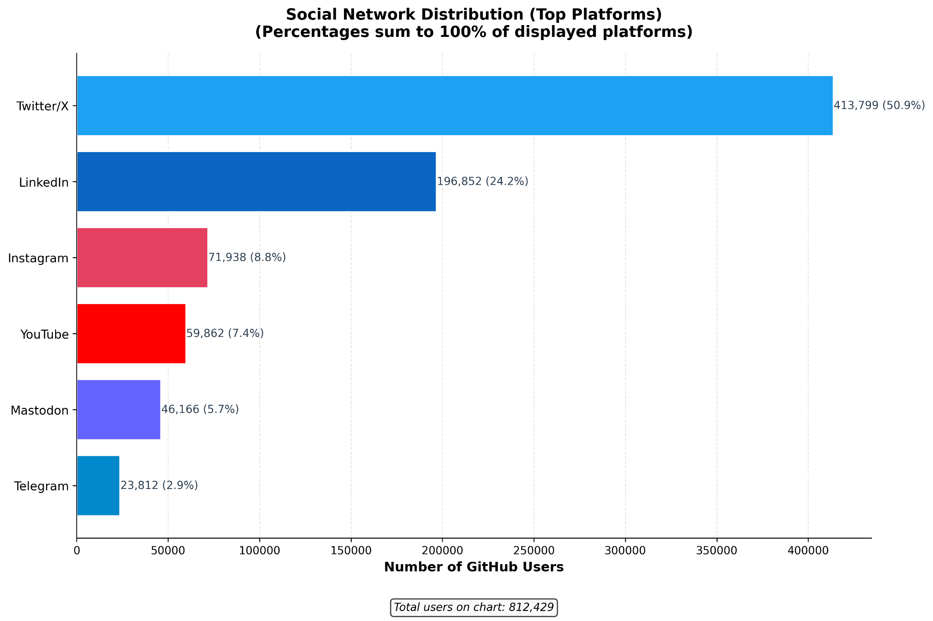

Slide 19
Conclusion and Future Directions
Contributions
Limitations
Future Work
Scalable GitHub data collection system (3.5M users)
Validated GitHub h-index metric: repositories → stars
Random Forest model: R² = 0.9486, MAE = 0.106
First large-scale social network mapping for GitHub devs
Model underestimates extreme h-index values
Data collection prioritized popular users
Deep learning / quantile regression for tail values
Temporal features: contribution velocity, star growth
Expand to PRs, reviews, contribution graphs
Notes:
In conclusion, I delivered a scalable data collection system for 3.5 million users and validated the GitHub h-index metric.
Recommendation: Use the Baseline model for ranking users with h < 30, and the Log2 model for classifying impact levels.
Future work includes using deep learning for tail values and adding temporal features like contribution velocity.
Thank you for your attention.

Slide 20
Thank you for your attention

